Slide 1


Llangynwyd Primary School
Meet the Teacher
2025-2026

Slide 2

Aims of tonight
  Teaching Team
  Attendance
  Uniform
  Weekly Routines
  Topic overview
  Welsh Phrases that we will be using
  Reading Books
  Anything else you want!

Slide 3
Croeso i
Dosbarth Porffor!
Welcome to Purple class!
We are a class of 12 Year 5 to Year 6 pupils.

Slide 4

Meet the Team
Class Teacher
Mr Thomas
Learning Support Assistants
  Mrs Cox
We love to help your child learn in fun and new ways!
We strive to help your child do their best and to take leaps
to reach their potential.

Slide 5
Attendance
Attendance focuses very highly on our school priorities this year as we strive to reach targets set by Welsh Government and the Local Authority.

Slide 6
Attendance
What we are doing to improve attendance:
Mrs Kehoe monitors attendance every 2/3 weeks with the BCBC Education Welfare Officer
Letters will be sent to children whose attendance is causing concern.
EWO involvement for children whose attendance is showing no sign of improvement.
Callio letters will be sent home termly stating colour coded attendance.

Slide 7
Attendance
Children need to attend school every day.
Children need to attend school on time and by 8:50am.
Lateness is also monitored by our EWO.
If your child is ill, please contact the school office on day 1 of illness via telephone or email.
Please do not post messages to Teachers on Seesaw regarding attendance – it is vital the school office is informed.
If we do not have contact from you for 24 hours and we have not sighted your children, a referral will be made to Child Protection Services to ensure your child’s safety. +

Slide 8
Attendance
It has been proven that poor attendance drastically hinders a child’s chances of reaching their full potential!
Make sure your child is in school every day!

Slide 9

Uniform
School Uniform
White or Pale blue polo shirt
Royal Blue Cardigan or Jumper
Black or Grey Trousers, Shorts or Skirts
In the summer girls can wear blue summer dresses
MAKE SURE YOUR CHILD’s NAME IS ON EVERY JUMPER!

Slide 10
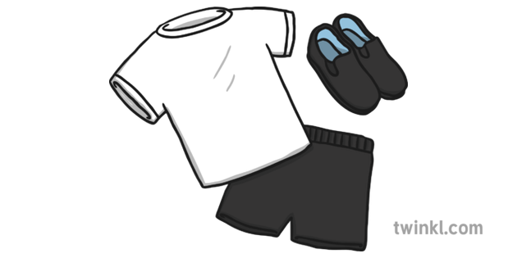
Uniform
PE KIT
White polo shirts and black, grey or navy shorts, leggings or tracksuit bottoms
Please ensure shorts are appropriate in length and are not “hot pants” style shorts.
No crop tops to be worn to school
Children can wear kit to school on designated PE Days (Wednesdays)

Slide 11
Daily Routine
Daily timetable:
8:55-9:30 – Registration & morning rotation
9:30-10:40 – Literacy
10:40-11:00 - Break
11:00-12:25 – Maths
12:25-13:25 - Lunch
13:30-13:50 – Assembly
13:50-15:30 – Topic / PE

Slide 12
Weekly Timetable
Weekly timetable:
PE – Wednesday afternoons
Reading Days – On reading records
Clubs – Monday
Mrs Powell - Thursday

Slide 13

Our Topic
This half term our topic will be;
What does it mean to live in a diverse world?

Slide 14
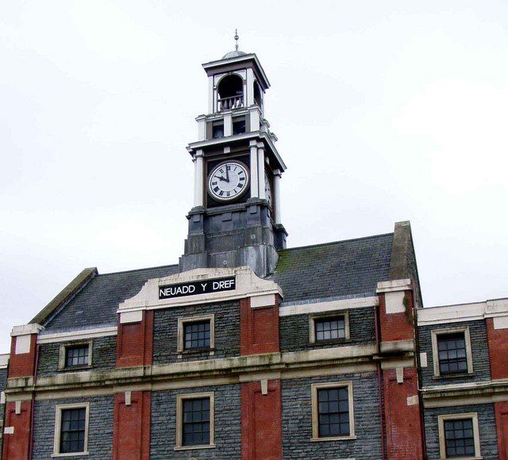
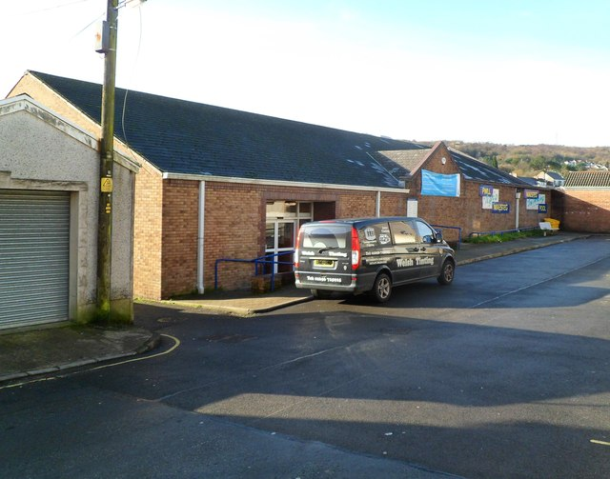
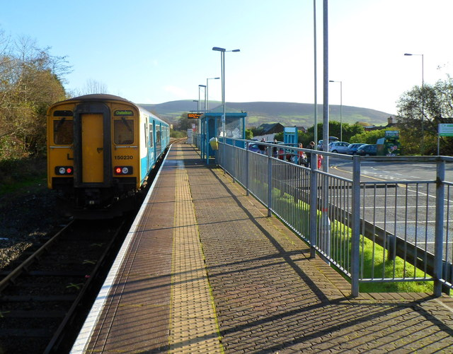
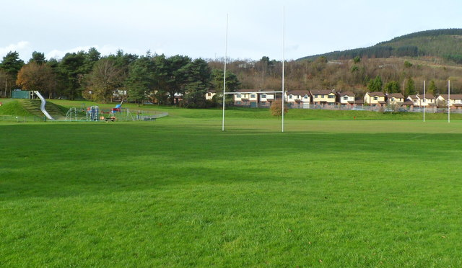
Welsh Phrases – Y Dref
Ble mae’r sinema?
Mae’r sinema ar y chwith.
Oes sinema yn y dref?
Oes, mae sinema yn y dref.
Wyt ti’n mynd i’r sinema?
Ydw, dw i’n mynd i’r sinema gyda ffrindiau ar ddydd Sadwrn.
Dw i’n mwynhau ‘Mynd i’r Dre‘ achos mae’n hwyl.
Ble mae’r plant yn mynd?
Pa liw ydy’r bws?
Ydy’r plant yn hapus?

Slide 15

We look forward to working with you and your children throughout the coming year.
We want to ensure each child’s time spent with us is happy and successful so please don’t hesitate to discuss and celebrate any news with the Porffor team, our door is always open.
Together we can!
Many thanks for your continued support,
Mr Thomas
Diolch!

